Slide 1
Database System
Chapter0: Course Introduction
Database Systems

Slide 2
General Information
Course Name: Database Systems
Time allocation: 30 slots (17 lectures, 13 Lab/Tutorials)
Main books / resources:
  Textbook: First Course in Database Systems, A, 3/E Jeffrey D. Ullman, Jennifer Widom ISBN-10: 013600637X
  FU slides
  FU CMS
  SQL Tutorial: https://www.w3schools.com/sql/default.asp
  Tool: SQL Server Developer Edition

Slide 3
Objectives
To provide students with
  Basic Knowledge on database models
  Designing relational database
  Skill in using SQL statements and SQL Server

Slide 4
Course content
Introduction to Database Systems and Database Management Systems
Design theory of Relational Databases
Relational Database Programming

Slide 5
Student’s task
Students must attend more than 80% of contact slots in order to be accepted to the final examination.
Student is responsible to do all assigned exercises/asignments given by instructor in class or at home and submit on time
Use laptop in class only for learning purpose
Promptly access to the FU CMS at http://cms.fpt.edu.vn for up-to-date course information

Slide 6
Assessment scheme
On-going Assessment:
  05 Labs 15%
  02 progress tests: 10%
  01 Assignment: 20%
  Practical exam 25%
Final Exam: 30%
Completion Criteria:
  Every on-going assessment component >0
  Final Exam Score >0 & Final Result >=5

Slide 7
Thank You !

Slide 8
Microsoft SQL Server
Microsoft SQL Server is a relational database management system developed by Microsoft. As a database server, it is a software product with the primary function of storing and retrieving data as requested by other software applications—which may run either on the same computer or on another computer across a network (including the Internet) (wikipedia)
Edition used in this course:
  SQL Server Developer Edition (free for being used as development and test system, not as production server)

Slide 9
Setup steps
Run ISO file
In Installation tab of SQL Server Installation Center window:
  choose New SQL Server stand-alone installation or add features to an existing installation
In Product Key, choose Specify a free edition, and Developer then Next.
Check I accept the license terms then Next.

Slide 10
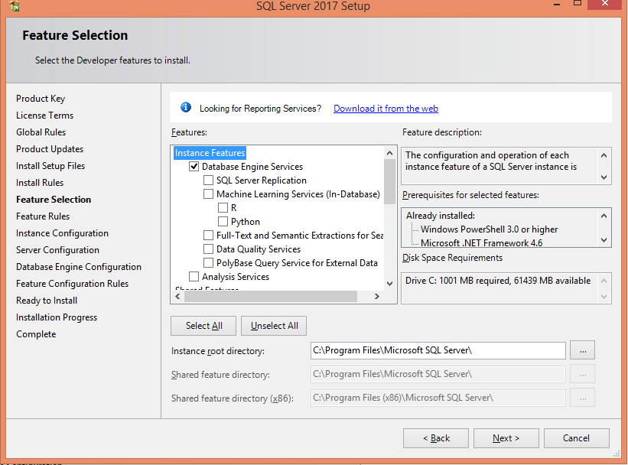
Select options and Set directory

Slide 11
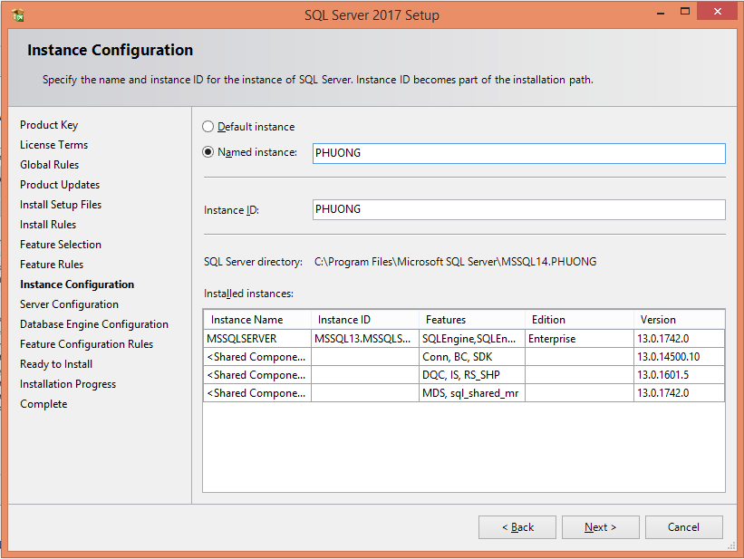
Select the default instance or provide a name for a named instance

Slide 12
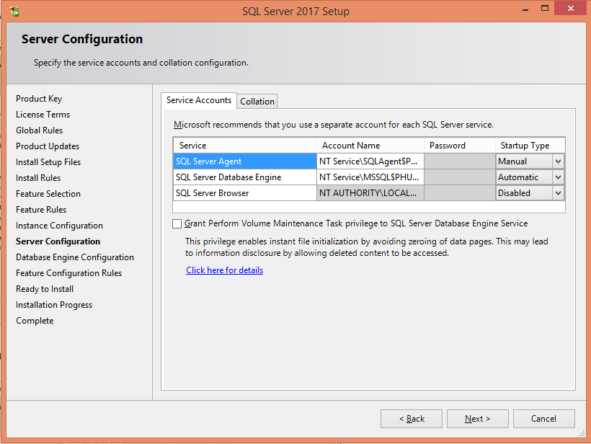
Review Server Configuration

Slide 13
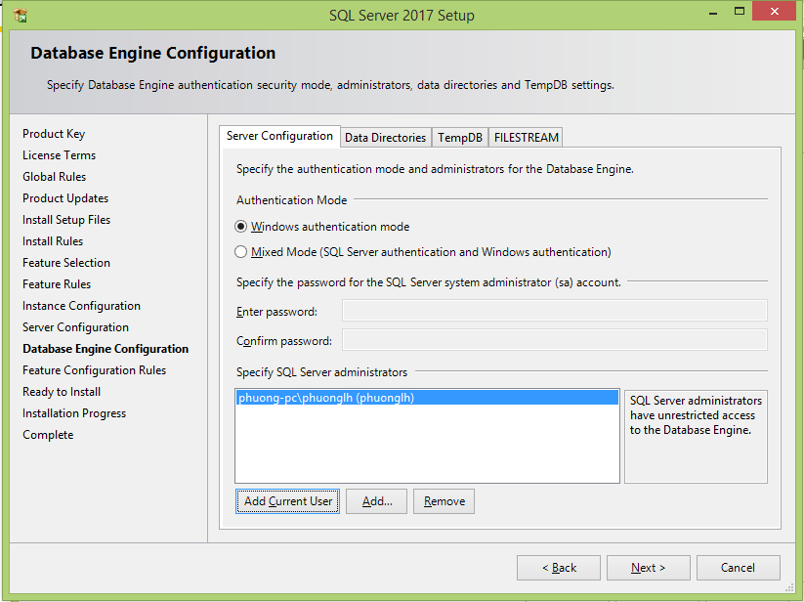
Configure Security

Slide 14
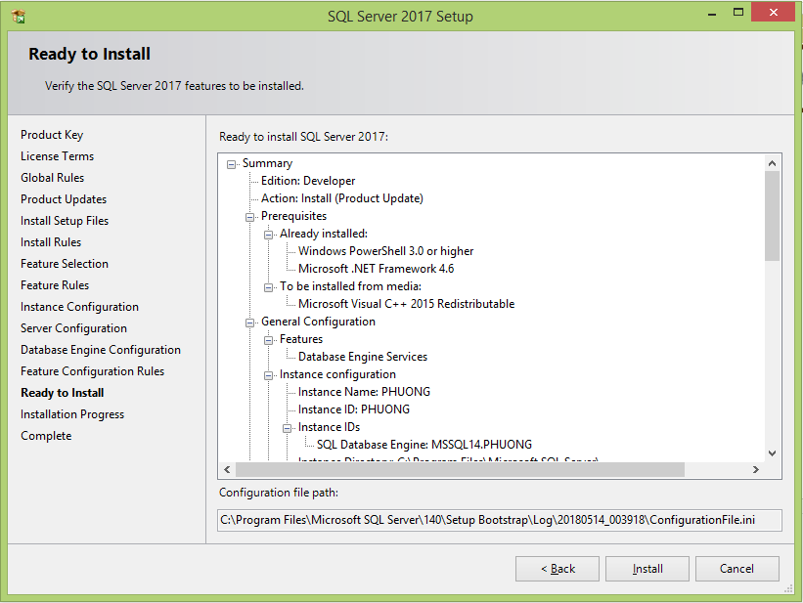
Install

